Slide 1
How to use OneDrive
The basics of the Online Portal

Slide 2
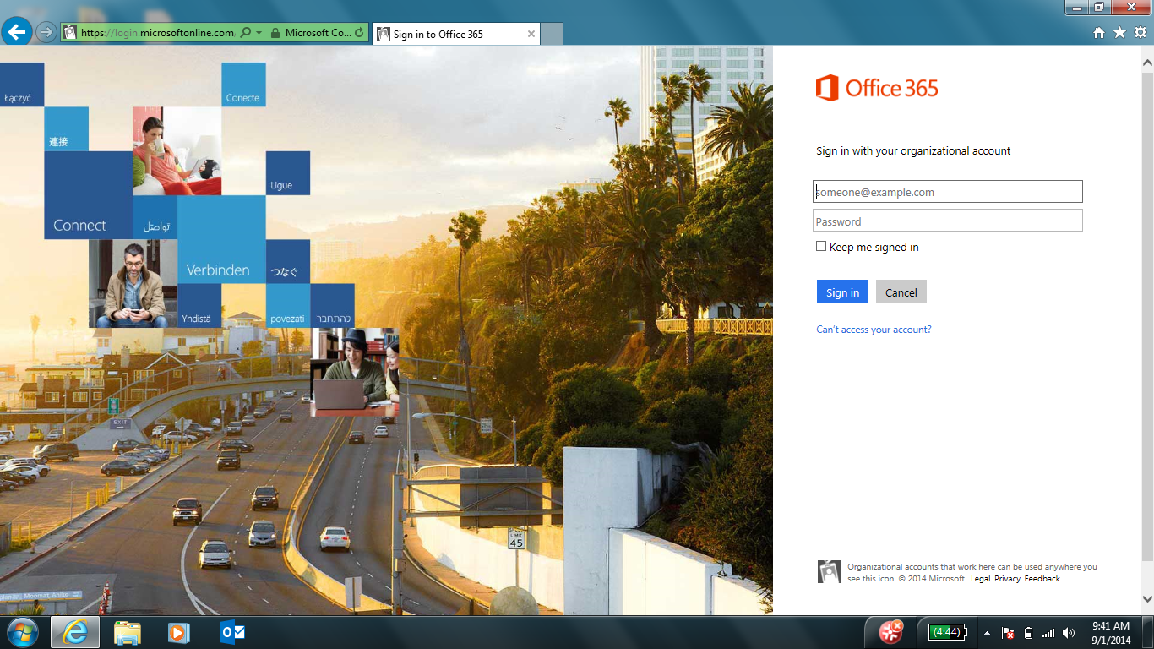
Logging In
Open a web browser an navigate to Portal.Office.com
Teachers will login using Firstname.Lastname@evsc.k12.in.us
Students will login using Firstname.Lastname@evsck12.com

Slide 3
Navigating to OneDrive
Once you are logged in, you will be taken to the default homepage. At the top of the screen is a toolbar that is used for navigation to the different parts of the portal.
By clicking on the OneDrive section of the toolbar, you will be taken to the Personal storage section. This is where you can create, upload, view, edit and share files in OneDrive.

Slide 4
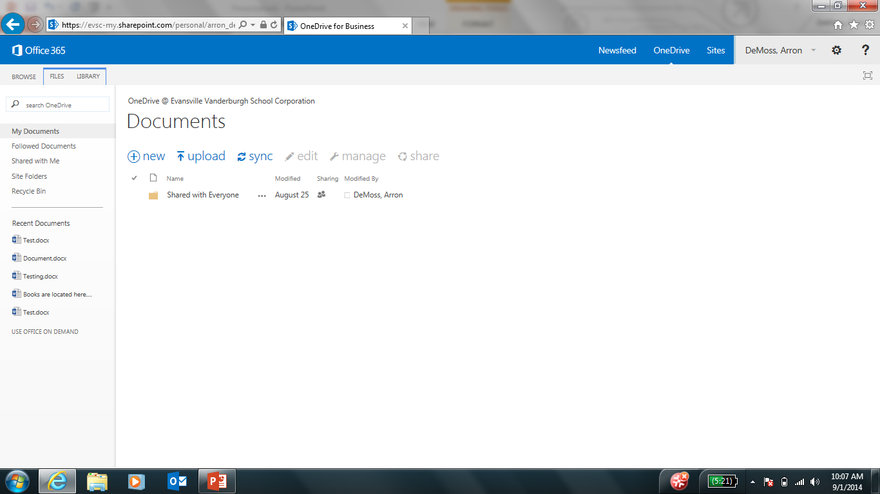
OneDrive Main Page
This is the main page for OneDrive’s online portal.

Slide 5
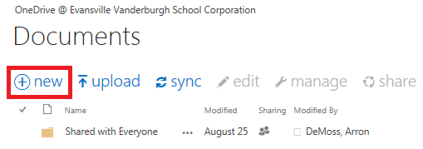
OneDrive Main Page Cont.
There are two options for adding files to OneDrive from the portal. New and Upload.
New allows your to create a new Word document, Powerpoint presentation, Excel spreadsheet, Onenote notebook or Excel survey using the online tools. These tools are basically an online version of their respective programs.
It also allows you to create new folders in your OneDrive directory in order to sort, organize and share what you have saved.

Slide 6
OneDrive Main Page Cont.
Upload allows you to upload files from your computer to your OneDrive directory.
When selected, it will open a window that allows you to browse your computer for a file that you want to upload. This does not have to be an Office file, it can be any kind of file you want to upload.
This option will upload into whatever folder you currently have open. If you want to upload into a specific folder, open that folder and choose upload from there.

Slide 7
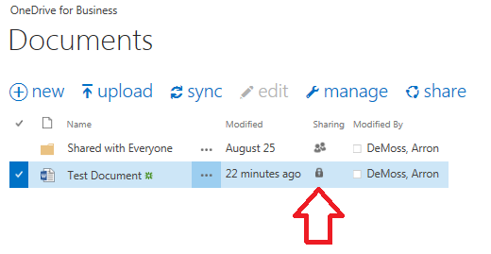
Sharing a File
Once you have a file created or uploaded, you will want to know how to share it with others. There are 2 ways to do this.
First click the lock icon on the file you want to share.

Slide 8
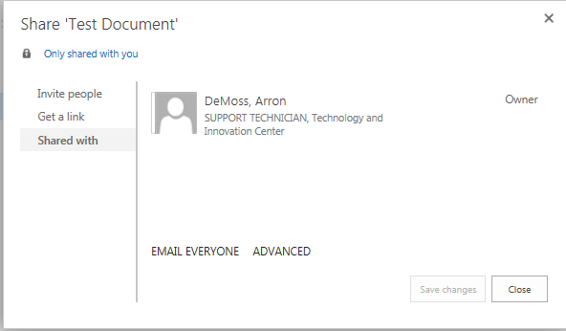
Sharing a File
This will bring up the sharing window. This shows you who the file is currently shared with, as well as letting you share it with others.

Slide 9
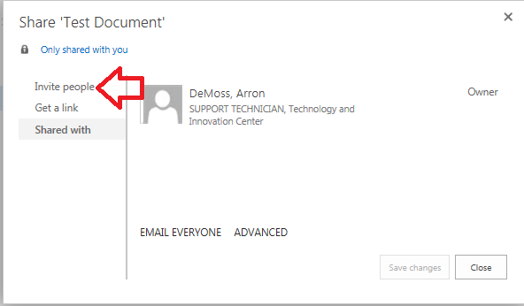
Sharing a File
The two methods of sharing a file are by inviting them, or by generating a link to email out to others.
The Invite People option allows you to search for users to share with, as well as selecting if those uses can view or edit the document.

Slide 10
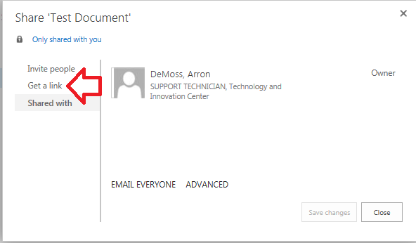
Sharing a File
The Get a Link option allows you to generate a link to email out to users that will allow them to access the file. Anyone that has this link will be able to view or edit the file depending on the link they have access to.

Slide 11
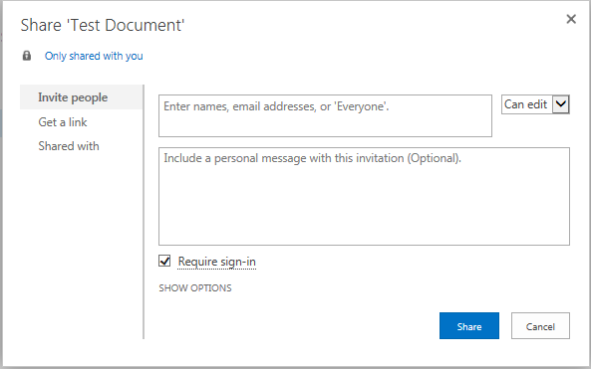
Inviting People
Selecting Invite People will bring up the following window.
The top box allows you to search for people by name which should autofill if the user is in EVSC’s system.
The drop down menu to the right allows you to select if the users can edit the file, or only view it.
Finally, the bottom box allows you to add a message to the users.

Slide 12
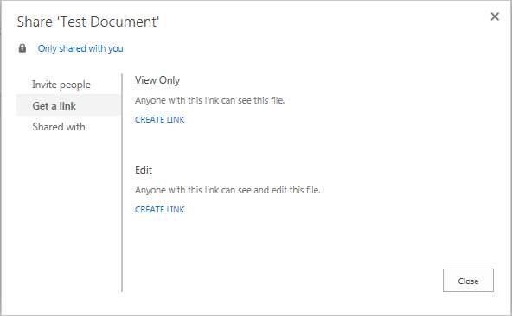
Sharing with a Link
Selecting the Get a Link option with open the following window. This has two options available.
The top option will generate a link that allows users to View the file but not make changes to it.
The bottom option allows the users to edit and thus make changes to the file.
Remember that anyone that gets this link will have access to the file.

Slide 13
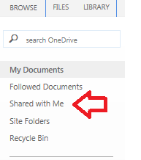
Viewing Shared Files
Now that you have shared your files or folders, you will want to know how people can view them.
On the left hand side of the screen, there is a link title “Shared With Me” Clicking this will bring up a window that allows you to see everything that has been shared with you.

Slide 14
Shared Files Continued
Remember that all of the steps involved in sharing a file can also be used to share a folder.
When sharing a folder, user will have the same rights to the files inside of the folder that they do to the folder itself. Meaning that if you share a folder and give the users access to edit it, they will be able to add and remove files within that folder.

Slide 15
Editing Office Files
When you click on a file, if it is an office file, it will open in your browser so you can view it online. If you want to edit it, Select edit document in the top left of your screen.
You will be given the option to edit online, or use the appropriate application if you have it on your computer. Example, Word if the file is a document.
Changes will be saved automatically if you select the Edit online option. If you select the other option, once you click save in the application, it will update the online version.

Slide 16
Downloading Files
If you want to download a file to your computer to have a local copy you have 2 options.
If you select the file and click Manage, there is an option to ‘Download a Copy.” This will allow you to select the destination and name for your local copy.
If you open the file by clicking on it’s name, it will look differently if it is an office file or not.
If it is not an office file, there will simply be a Download button in the top left corner.
If it is an office file, select File in the top left, then Save As, then Download.

Slide 17
More Information
This concludes the basics of storing and sharing files / folders in the web portal of OneDrive.
If you want to know more including Uploading from Office applications, Team sites and more, please see our other presentations.

